Slide 1


Slide 2


Slide 3
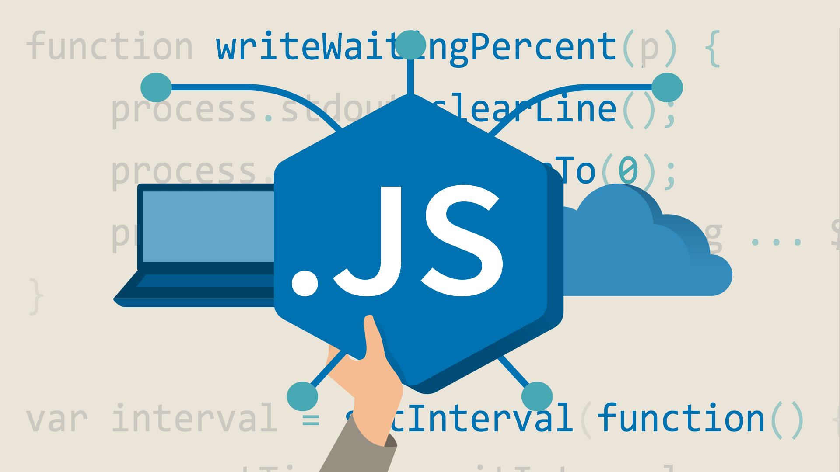
Muhammad Umar Ahmad

Slide 4
Introduction to JS
Muhammad Umar Ahmad

Slide 5
What is JavaScript?
JavaScript is the programming language of HTML and the Web.
JavaScript Can Show/Hide HTML Elements
JavaScript Can Change HTML Styles (CSS)
JavaScript Can Change HTML Attribute Values
JavaScript Can Change HTML Content
Muhammad Umar Ahmad

Slide 6
Examples
https://www.w3schools.com/js/tryit.asp?filename=tryjs_intro_inner_html
https://www.w3schools.com/js/tryit.asp?filename=tryjs_intro_lightbulb
https://www.w3schools.com/js/tryit.asp?filename=tryjs_intro_style
https://www.w3schools.com/js/tryit.asp?filename=tryjs_intro_hide
https://www.w3schools.com/js/tryit.asp?filename=tryjs_intro_show
Muhammad Umar Ahmad

Slide 7
Why Study JavaScript?
JavaScript is one of the 3 languages all web developers must learn:
HTML - to define the content of web pages
CSS - to specify the layout of web pages
JavaScript - to program the behavior of web pages
Web pages are not the only place where JavaScript is used. Many desktop and server programs use JavaScript. Node.js is the best known.
Muhammad Umar Ahmad

Slide 8
What kind of applications we can create after learning
JavaScript Module
Muhammad Umar Ahmad

Slide 9
Example Projects
https://personal-sticky-notes.web.app/
https://calculator-js.web.app/
https://beat-the-button.web.app/
https://balloon-popping-game.web.app/
https://www.olx.com.pk/ (Current Version: React)
*** We would have hands-on practice in some of these projects during this module. ***
Muhammad Umar Ahmad

Slide 10
Let’s Start JavaScript
Muhammad Umar Ahmad

Slide 11

Muhammad Umar Ahmad

Slide 12
Why Waiting now?
Before Starting JavaScript.
You must understand that you're going to learn programming. and willing to become a Programmer.
And the only way to become a clever programmer is to:
Study. Study. Study.
Practice. Practice. Practice.
AND
Code. Code. Code!
Muhammad Umar Ahmad

Slide 13
Now Let’s Start JavaScript
Muhammad Umar Ahmad

Slide 14
Where to write JavaScript?
In HTML, JavaScript code must be inserted between <script> and </script> tags.
External JavaScript
Scripts can also be placed in external files:
JavaScript files have the file extension .js
<script src="myScript.js"></script>
Muhammad Umar Ahmad

Slide 15
JavaScript Output
Muhammad Umar Ahmad

Slide 16
Alerts
An alert is a box that pops up to give the user a message.
Here's code for an alert that displays the message "Thank you"
alert("Thank you");
Muhammad Umar Ahmad

Slide 17
console.log()
For debugging purposes, you can call the console.log() method in the browser to display data.
Here's code that displays the message in console section of developer tools "Thank you".
console.log("Thank you");
Muhammad Umar Ahmad

Slide 18
More Basics
Muhammad Umar Ahmad

Slide 19
Strings
In coding, the quoted text "Thank you" is called a text string or simply a string.
e.g:
"Umar"
"I love Pakistan"
"25"
Muhammad Umar Ahmad

Slide 20
Numbers
Numbers without quotation marks are simple Numbers
e.g:
25
50
50000
Muhammad Umar Ahmad

Slide 21
Variables
A variable is a word that refers to a particular value.
JavaScript variables are containers for storing data values.
e.g:
var x = 5;
var y = 6;
var z = x + y;
var name = "Umar";
Muhammad Umar Ahmad

Slide 22
Let’s Dive Deeply into our JavaScript Book
Muhammad Umar Ahmad

Slide 23
Thanks!
Muhammad Umar Ahmad
Any questions?

